Slide 1

Transport Layer Part 2
Mark Allman
mallman@case.edu
EECS 325/425
Fall 2018
“Well, we busted outa class, had to get away from those fools,
We learned more from a three minute record than we ever learned in school.”

Slide 2
These slides are more-or-less directly from the slide set developed by Jim Kurose and Keith Ross for their book “Computer Networking: A Top Down Approach, 5th edition”.
The slides have been lightly adapted for Mark Allman’s EECS 325/425 Computer Networks class at Case Western Reserve University.
All material copyright 1996-2010
J.F Kurose and K.W. Ross, All Rights Reserved
Allman
2

Slide 3
Connectionless demultiplexing

Slide 4
Connectionless demultiplexing
create UDP sockets with host-local port numbers:
DatagramSocket | mySocket1 | = | new | DatagramSocket(12534);
DatagramSocket | mySocket2 | = | new | DatagramSocket(12535);

Slide 5
Connectionless demultiplexing
create UDP sockets with host-local port numbers:
when creating datagram to send into UDP socket, must specify: (dest IP address, dest port number)
DatagramSocket | mySocket1 | = | new | DatagramSocket(12534);
DatagramSocket | mySocket2 | = | new | DatagramSocket(12535);

Slide 6
Connectionless demultiplexing
create UDP sockets with host-local port numbers:
DatagramSocket | mySocket1 | = | new | DatagramSocket(12534);
DatagramSocket | mySocket2 | = | new | DatagramSocket(12535);
when creating datagram to send into UDP socket, must specify: (dest IP address, dest port number)
when host receives UDP segment:
checks destination port number in segment
directs UDP segment to socket with that port number

Slide 7
Connectionless demultiplexing
create UDP sockets with host-local port numbers:
DatagramSocket | mySocket1 | = | new | DatagramSocket(12534);
DatagramSocket | mySocket2 | = | new | DatagramSocket(12535);
when creating datagram to send into UDP socket, must specify: (dest IP address, dest port number)
when host receives UDP segment:
checks destination port number in segment
directs UDP segment to socket with that port number
IP datagrams with different source IP addresses and/ or source port numbers directed to same socket
i.e., demuxing based on destination port only

Slide 8
Connectionless demux (cont)
DatagramSocket serverSocket = new DatagramSocket(6428);
P2
P3
P1
P1
client IP: A
server IP: C
Client
IP:B

Slide 9
Connectionless demux (cont)
DatagramSocket serverSocket = new DatagramSocket(6428);
P2
P3
P1
P1
SP: 9157
client IP: A
DP: 6428
server IP: C
Client
IP:B

Slide 10
Connectionless demux (cont)
DatagramSocket serverSocket = new DatagramSocket(6428);
P2
P3
P1
P1
SP: 9157
SP: 5775
client IP: A
DP: 6428
server IP: C
DP: 6428
Client
IP:B

Slide 11
Connectionless demux (cont)
DatagramSocket serverSocket = new DatagramSocket(6428);
P2
P3
P1
P1
SP: 6428
DP: 9157
SP: 9157
SP: 5775
client IP: A
DP: 6428
server IP: C
DP: 6428
Client
IP:B

Slide 12
Connectionless demux (cont)
DatagramSocket serverSocket = new DatagramSocket(6428);
P2
P3
P1
P1
SP: 6428
SP: 6428
DP: 9157
DP: 5775
SP: 9157
SP: 5775
client IP: A
DP: 6428
server IP: C
DP: 6428
Client
IP:B

Slide 13
Connectionless demux (cont)
DatagramSocket serverSocket = new DatagramSocket(6428);
P2
P3
P1
P1
SP: 6428
SP: 6428
DP: 9157
DP: 5775
SP: 9157
SP: 5775
client IP: A
DP: 6428
server IP: C
DP: 6428
Client
IP:B
SP provides “return address”

Slide 14
More Complex Demux-ing
P1
P4
P2
P1
P3
SP: 5775
DP: 80
S-IP: B
D-IP:C
SP: 9157
SP: 9157
client IP: A
DP: 80
server IP: C
DP: 80
Client
IP:B
S-IP: A
S-IP: B
D-IP:C
D-IP:C

Slide 15

Reading Along ...
3.3: Connectionless Transport: UDP
Allman
6

Slide 16
UDP: User Datagram Protocol [RFC 768]

Slide 17
UDP: User Datagram Protocol [RFC 768]
“no frills,” “bare bones” Internet transport protocol

Slide 18
UDP: User Datagram Protocol [RFC 768]
“no frills,” “bare bones” Internet transport protocol
“best effort” service, UDP segments may be:

Slide 19
UDP: User Datagram Protocol [RFC 768]
“no frills,” “bare bones” Internet transport protocol
“best effort” service, UDP segments may be:
lost
delivered out of order to app

Slide 20
UDP: User Datagram Protocol [RFC 768]
“no frills,” “bare bones” Internet transport protocol
“best effort” service, UDP segments may be:
lost
delivered out of order to app
connectionless:
no handshaking between UDP sender, receiver
each UDP segment handled independently of others
Transport Layer
3-

Slide 21
UDP: User Datagram Protocol [RFC 768]
“no frills,” “bare bones” Internet transport protocol
“best effort” service, UDP segments may be:
lost
delivered out of order to app
connectionless:
no handshaking between UDP sender, receiver
each UDP segment handled independently of others
Why is there a UDP?
Transport Layer
3-

Slide 22
UDP: User Datagram Protocol [RFC 768]
“no frills,” “bare bones” Internet transport protocol
“best effort” service, UDP segments may be:
lost
delivered out of order to app
connectionless:
no handshaking between UDP sender, receiver
each UDP segment handled independently of others
Why is there a UDP?
no connection establishment (which can add delay)
simple: no connection state at sender, receiver
small segment header
no congestion control: UDP can blast away as fast as desired
Transport Layer
3-

Slide 23
UDP
often used for streaming multimedia apps
loss tolerant
rate controllable
other UDP uses
DNS
SNMP
reliable transfer over UDP: add reliability at application layer
32 bits
source port # dest port # length checksum
Application data (message)
UDP segment format
 application-specific error recovery!

Slide 24
UDP
often used for streaming multimedia apps
32 bits
source port # dest port # length checksum
loss tolerant
rate controllable
other UDP uses
DNS
SNMP
Length, in
bytes of UDP
segment, including header
Application data (message)
reliable transfer over UDP: add reliability at application layer
UDP segment format
 application-specific error recovery!

Slide 25
UDP checksum

Slide 26
UDP checksum
Goal: detect “errors” (e.g., flipped bits) in transmitted segment

Slide 27
UDP checksum
Goal: detect “errors” (e.g., flipped bits) in transmitted segment
Sender:
treat segment contents as sequence of 16-bit integers
checksum: addition (1’s complement sum) of segment contents
sender puts checksum value into UDP checksum field

Slide 28
UDP checksum
Goal: detect “errors” (e.g., flipped bits) in transmitted segment
Sender:
treat segment contents as sequence of 16-bit integers
checksum: addition (1’s complement sum) of segment contents
sender puts checksum value into UDP checksum field
Receiver:
compute checksum of received segment
check if computed checksum equals checksum field value:
NO - error detected
YES - no error detected.

Slide 29
UDP checksum
Goal: detect “errors” (e.g., flipped bits) in transmitted segment
Sender:
treat segment contents as sequence of 16-bit integers
checksum: addition (1’s complement sum) of segment contents
sender puts checksum value into UDP checksum field
Receiver:
compute checksum of received segment
check if computed checksum equals checksum field value:
NO - error detected
YES - no error detected.
 But maybe errors nonetheless?

Slide 30
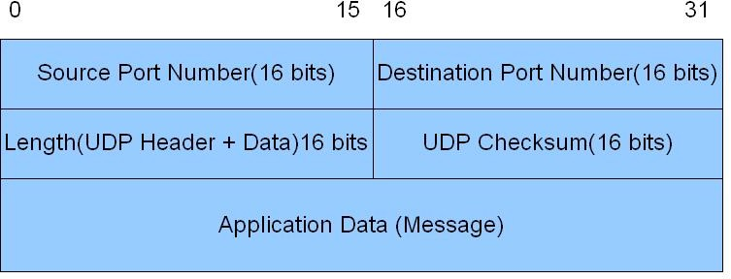
UDP Packet Header

Slide 31
A Tangent…
Binary number: 0111

Slide 32
Reading Along ...
3.4: Principles of reliable data transfer
Allman
12

Slide 33
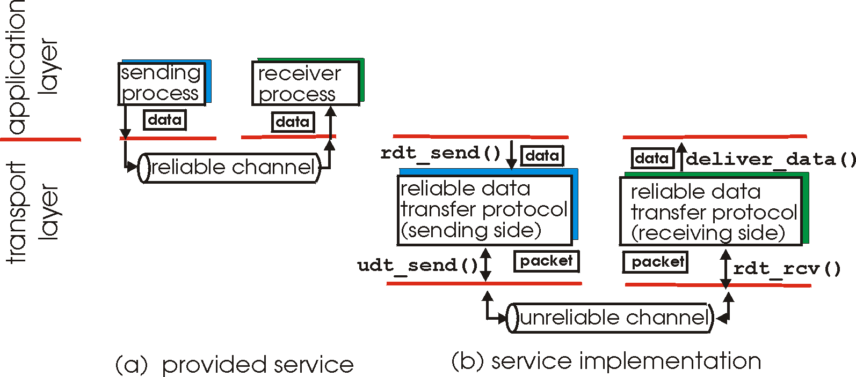
Principles of Reliable data transfer
important in app., transport, link layers
top-10 list of important networking topics!

Slide 34
Principles of Reliable data transfer
important in app., transport, link layers
top-10 list of important networking topics!

Slide 35
Principles of Reliable data transfer
important in app., transport, link layers
top-10 list of important networking topics!

Slide 36
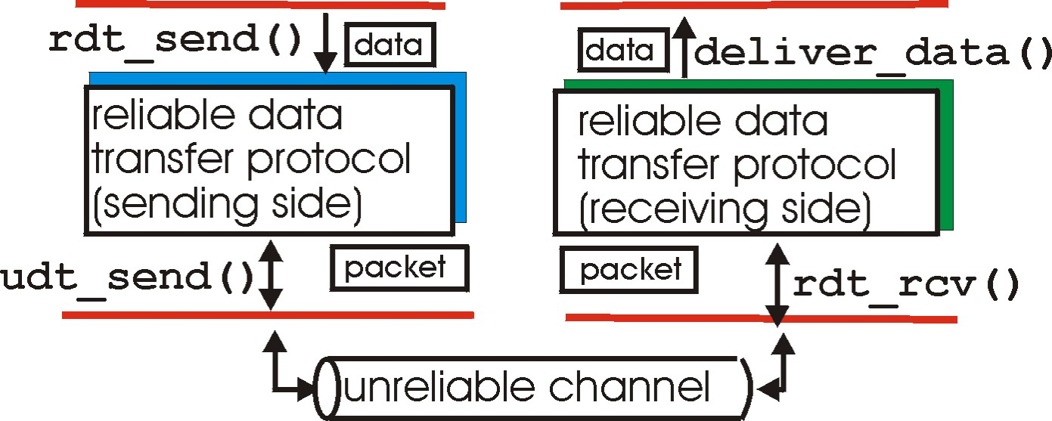
Reliable data transfer: getting started
send side
receive side

Slide 37
Reliable data transfer: getting started
rdt_send(): called from above, (e.g., by app.). Passed data to deliver to receiver upper layer
send side
receive side

Slide 38
Reliable data transfer: getting started
rdt_send(): called from above, (e.g., by app.). Passed data to deliver to receiver upper layer
send side
receive side
udt_send(): called by rdt,
to transfer packet over unreliable channel to receiver

Slide 39
Reliable data transfer: getting started
rdt_send(): called from above, (e.g., by app.). Passed data to deliver to receiver upper layer
send side
receive side
udt_send(): called by rdt,
to transfer packet over unreliable channel to receiver
rdt_rcv(): called when packet
arrives on rcv-side of channel

Slide 40
Reliable data transfer: getting started
rdt_send(): called from above, (e.g., by app.). Passed data to deliver to receiver upper layer
deliver_data(): called by
rdt to deliver data to upper
send side
receive side
udt_send(): called by rdt,
to transfer packet over unreliable channel to receiver
rdt_rcv(): called when packet
arrives on rcv-side of channel

Slide 41
Reliable data transfer: getting started

Slide 42
Reliable data transfer: getting started
We’ll:
incrementally develop sender, receiver sides of reliable data transfer protocol (rdt)
consider only unidirectional data transfer
 but control info will flow in both directions!
use finite state machines (FSM) to specify sender, receiver

Slide 43
Reliable data transfer: getting started
We’ll:
incrementally develop sender, receiver sides of reliable data transfer protocol (rdt)
consider only unidirectional data transfer
 but control info will flow in both directions!
use finite state machines (FSM) to specify sender, receiver
state: when in this “state” next state uniquely determined
by next event
state 1
state 2

Slide 44
Reliable data transfer: getting started
We’ll:
incrementally develop sender, receiver sides of reliable data transfer protocol (rdt)
consider only unidirectional data transfer
 but control info will flow in both directions!
use finite state machines (FSM) to specify
sender, receiver
event causing state transition actions taken on state transition
state: when in this “state” next state uniquely determined
by next event
state 1
state 2
event actions

Slide 45
Rdt1.0: reliable transfer over a reliable channel

Slide 46
Rdt1.0: reliable transfer over a reliable channel
underlying channel perfectly reliable
no bit errors
no loss of packets

Slide 47
Rdt1.0: reliable transfer over a reliable channel
underlying channel perfectly reliable
no bit errors
no loss of packets
separate FSMs for sender, receiver:
sender sends data into underlying channel
receiver read data from underlying channel

Slide 48
Rdt1.0: reliable transfer over a reliable channel
underlying channel perfectly reliable
no bit errors
no loss of packets
separate FSMs for sender, receiver:
sender sends data into underlying channel
receiver read data from underlying channel
Wait for call from above
rdt_send(data)
packet = make_pkt(data) udt_send(packet)
sender

Slide 49
Rdt1.0: reliable transfer over a reliable channel
underlying channel perfectly reliable
no bit errors
no loss of packets
separate FSMs for sender, receiver:
sender sends data into underlying channel
receiver read data from underlying channel
Wait for call from above
rdt_send(data)
Wait for call from below
rdt_rcv(packet)
packet = make_pkt(data) udt_send(packet)
extract (packet,data) deliver_data(data)
sender
receiver

Slide 50
Rdt 1.0

Slide 51
Rdt 1.0
Obviously unrealistic assumptions!
If that was all there was to it, there’d be little reason to even bring it up!

Slide 52
Rdt2.0: channel with bit errors

Slide 53
Rdt2.0: channel with bit errors
How do humans recover from “errors”
during conversation?

Slide 54
Rdt2.0: channel with bit errors

Slide 55
Rdt2.0: channel with bit errors
underlying channel may flip bits in packet
 checksum to detect bit errors

Slide 56
Rdt2.0: channel with bit errors
underlying channel may flip bits in packet
 checksum to detect bit errors
the question: how to recover from errors:

Slide 57
Rdt2.0: channel with bit errors
underlying channel may flip bits in packet
checksum to detect bit errors
the question: how to recover from errors:
acknowledgements (ACKs): receiver explicitly tells sender that pkt received OK

Slide 58
Rdt2.0: channel with bit errors
underlying channel may flip bits in packet
checksum to detect bit errors
the question: how to recover from errors:
acknowledgements (ACKs): receiver explicitly tells sender that pkt received OK
negative acknowledgements (NAKs): receiver explicitly tells sender that pkt had errors

Slide 59
Rdt2.0: channel with bit errors
underlying channel may flip bits in packet
checksum to detect bit errors
the question: how to recover from errors:
acknowledgements (ACKs): receiver explicitly tells sender that pkt received OK
negative acknowledgements (NAKs): receiver explicitly tells sender that pkt had errors
sender retransmits pkt on receipt of NAK

Slide 60
Rdt2.0: channel with bit errors
underlying channel may flip bits in packet
checksum to detect bit errors
the question: how to recover from errors:
acknowledgements (ACKs): receiver explicitly tells sender that pkt received OK
negative acknowledgements (NAKs): receiver explicitly tells sender that pkt had errors
sender retransmits pkt on receipt of NAK
new mechanisms in rdt2.0 (beyond rdt1.0):
error detection
receiver feedback: control msgs (ACK,NAK) rcvr->sender

Slide 61
rdt2.0: FSM specification
rdt_send(data)
sndpkt = make_pkt(data, checksum) udt_send(sndpkt)
_{Wait for Wait for} rdt_rcv(rcvpkt) &&
_{call from ACK or} isNAK(rcvpkt)
_{above NAK} udt_send(sndpkt)
rdt_rcv(rcvpkt) && isACK(rcvpkt)
Λ
sender
receiver
rdt_rcv(rcvpkt) && corrupt(rcvpkt)
udt_send(NAK)
Wait for call from below
rdt_rcv(rcvpkt) && notcorrupt(rcvpkt)
extract(rcvpkt,data) deliver_data(data) udt_send(ACK)

Slide 62
rdt2.0: FSM specification
rdt_send(data)
sndpkt = make_pkt(data, checksum) udt_send(sndpkt)
receiver
rdt_rcv(rcvpkt) && corrupt(rcvpkt)
Wait for call from above
Wait for ACK or NAK
rdt_rcv(rcvpkt) &&
isNAK(rcvpkt)
udt_send(sndpkt)
udt_send(NAK)
rdt_rcv(rcvpkt) && isACK(rcvpkt)
Wait for call from below
Λ
sender
rdt_rcv(rcvpkt) && notcorrupt(rcvpkt)
extract(rcvpkt,data) deliver_data(data) udt_send(ACK)

Slide 63
rdt2.0: operation with no errors
rdt_send(data)
snkpkt = make_pkt(data, checksum) udt_send(sndpkt)
rdt_rcv(rcvpkt) &&
receiver
isNAK(rcvpkt)
Wait for call from above
Wait for ACK or NAK
rdt_rcv(rcvpkt) && corrupt(rcvpkt)
udt_send(sndpkt)
udt_send(NAK)
rdt_rcv(rcvpkt) && isACK(rcvpkt)
Λ
sender
Wait for call from below
rdt_rcv(rcvpkt) && notcorrupt(rcvpkt)
extract(rcvpkt,data) deliver_data(data) udt_send(ACK)

Slide 64
rdt2.0: operation with no errors
rdt_send(data)
snkpkt = make_pkt(data, checksum) udt_send(sndpkt)
rdt_rcv(rcvpkt) &&
receiver
isNAK(rcvpkt)
Wait for call from above
Wait for ACK or NAK
rdt_rcv(rcvpkt) && corrupt(rcvpkt)
udt_send(sndpkt)
udt_send(NAK)
rdt_rcv(rcvpkt) && isACK(rcvpkt)
Λ
sender
Wait for call from below
rdt_rcv(rcvpkt) && notcorrupt(rcvpkt)
extract(rcvpkt,data) deliver_data(data) udt_send(ACK)

Slide 65
rdt2.0: operation with no errors
rdt_send(data)
snkpkt = make_pkt(data, checksum) udt_send(sndpkt)
rdt_rcv(rcvpkt) &&
receiver
isNAK(rcvpkt)
Wait for call from above
Wait for ACK or NAK
rdt_rcv(rcvpkt) && corrupt(rcvpkt)
udt_send(sndpkt)
udt_send(NAK)
rdt_rcv(rcvpkt) && isACK(rcvpkt)
Λ
sender
Wait for call from below
rdt_rcv(rcvpkt) && notcorrupt(rcvpkt)
extract(rcvpkt,data) deliver_data(data) udt_send(ACK)

Slide 66
rdt2.0: operation with no errors
rdt_send(data)
snkpkt = make_pkt(data, checksum) udt_send(sndpkt)
rdt_rcv(rcvpkt) &&
receiver
isNAK(rcvpkt)
Wait for call from above
Wait for ACK or NAK
rdt_rcv(rcvpkt) && corrupt(rcvpkt)
udt_send(sndpkt)
udt_send(NAK)
rdt_rcv(rcvpkt) && isACK(rcvpkt)
Λ
sender
Wait for call from below
rdt_rcv(rcvpkt) && notcorrupt(rcvpkt)
extract(rcvpkt,data) deliver_data(data) udt_send(ACK)

Slide 67
rdt2.0: operation with no errors
rdt_send(data)
snkpkt = make_pkt(data, checksum) udt_send(sndpkt)
rdt_rcv(rcvpkt) &&
receiver
isNAK(rcvpkt)
Wait for call from above
Wait for ACK or NAK
rdt_rcv(rcvpkt) && corrupt(rcvpkt)
udt_send(sndpkt)
udt_send(NAK)
rdt_rcv(rcvpkt) && isACK(rcvpkt)
Λ
sender
Wait for call from below
rdt_rcv(rcvpkt) && notcorrupt(rcvpkt)
extract(rcvpkt,data) deliver_data(data) udt_send(ACK)

Slide 68
rdt2.0: operation with no errors
rdt_send(data)
snkpkt = make_pkt(data, checksum) udt_send(sndpkt)
rdt_rcv(rcvpkt) &&
receiver
isNAK(rcvpkt)
Wait for call from above
Wait for ACK or NAK
rdt_rcv(rcvpkt) && corrupt(rcvpkt)
udt_send(sndpkt)
udt_send(NAK)
rdt_rcv(rcvpkt) && isACK(rcvpkt)
Λ
sender
Wait for call from below
rdt_rcv(rcvpkt) && notcorrupt(rcvpkt)
extract(rcvpkt,data) deliver_data(data) udt_send(ACK)

Slide 69
rdt2.0: operation with no errors
rdt_send(data)
snkpkt = make_pkt(data, checksum) udt_send(sndpkt)
rdt_rcv(rcvpkt) &&
receiver
isNAK(rcvpkt)
Wait for call from above
Wait for ACK or NAK
rdt_rcv(rcvpkt) && corrupt(rcvpkt)
udt_send(sndpkt)
udt_send(NAK)
rdt_rcv(rcvpkt) && isACK(rcvpkt)
Λ
sender
Wait for call from below
rdt_rcv(rcvpkt) && notcorrupt(rcvpkt)
extract(rcvpkt,data) deliver_data(data) udt_send(ACK)

Slide 70
rdt2.0: operation with no errors
rdt_send(data)
snkpkt = make_pkt(data, checksum) udt_send(sndpkt)
rdt_rcv(rcvpkt) &&
receiver
isNAK(rcvpkt)
Wait for call from above
Wait for ACK or NAK
rdt_rcv(rcvpkt) && corrupt(rcvpkt)
udt_send(sndpkt)
udt_send(NAK)
rdt_rcv(rcvpkt) && isACK(rcvpkt)
Λ
sender
Wait for call from below
rdt_rcv(rcvpkt) && notcorrupt(rcvpkt)
extract(rcvpkt,data) deliver_data(data) udt_send(ACK)

Slide 71
rdt2.0: error scenario
rdt_send(data)
snkpkt = make_pkt(data, checksum) udt_send(sndpkt)
rdt_rcv(rcvpkt) &&
receiver
isNAK(rcvpkt)
Wait for call from above
Wait for ACK or NAK
rdt_rcv(rcvpkt) && corrupt(rcvpkt)
udt_send(sndpkt)
udt_send(NAK)
rdt_rcv(rcvpkt) && isACK(rcvpkt)
Λ
sender
Wait for call from below
rdt_rcv(rcvpkt) && notcorrupt(rcvpkt)
extract(rcvpkt,data) deliver_data(data) udt_send(ACK)

Slide 72
rdt2.0: error scenario
rdt_send(data)
snkpkt = make_pkt(data, checksum) udt_send(sndpkt)
rdt_rcv(rcvpkt) &&
receiver
isNAK(rcvpkt)
Wait for call from above
Wait for ACK or NAK
rdt_rcv(rcvpkt) && corrupt(rcvpkt)
udt_send(sndpkt)
udt_send(NAK)
rdt_rcv(rcvpkt) && isACK(rcvpkt)
Λ
sender
Wait for call from below
rdt_rcv(rcvpkt) && notcorrupt(rcvpkt)
extract(rcvpkt,data) deliver_data(data) udt_send(ACK)

Slide 73
rdt2.0: error scenario
rdt_send(data)
snkpkt = make_pkt(data, checksum) udt_send(sndpkt)
rdt_rcv(rcvpkt) &&
receiver
isNAK(rcvpkt)
Wait for call from above
Wait for ACK or NAK
rdt_rcv(rcvpkt) && corrupt(rcvpkt)
udt_send(sndpkt)
udt_send(NAK)
rdt_rcv(rcvpkt) && isACK(rcvpkt)
Λ
sender
Wait for call from below
rdt_rcv(rcvpkt) && notcorrupt(rcvpkt)
extract(rcvpkt,data) deliver_data(data) udt_send(ACK)

Slide 74
rdt2.0: error scenario
rdt_send(data)
snkpkt = make_pkt(data, checksum) udt_send(sndpkt)
rdt_rcv(rcvpkt) &&
receiver
isNAK(rcvpkt)
Wait for call from above
Wait for ACK or NAK
rdt_rcv(rcvpkt) && corrupt(rcvpkt)
udt_send(sndpkt)
udt_send(NAK)
rdt_rcv(rcvpkt) && isACK(rcvpkt)
Λ
sender
Wait for call from below
rdt_rcv(rcvpkt) && notcorrupt(rcvpkt)
extract(rcvpkt,data) deliver_data(data) udt_send(ACK)

Slide 75
rdt2.0: error scenario
rdt_send(data)
snkpkt = make_pkt(data, checksum) udt_send(sndpkt)
rdt_rcv(rcvpkt) &&
receiver
isNAK(rcvpkt)
Wait for call from above
Wait for ACK or NAK
rdt_rcv(rcvpkt) && corrupt(rcvpkt)
udt_send(sndpkt)
udt_send(NAK)
rdt_rcv(rcvpkt) && isACK(rcvpkt)
Λ
sender
Wait for call from below
rdt_rcv(rcvpkt) && notcorrupt(rcvpkt)
extract(rcvpkt,data) deliver_data(data) udt_send(ACK)

Slide 76
rdt2.0: error scenario
rdt_send(data)
snkpkt = make_pkt(data, checksum) udt_send(sndpkt)
rdt_rcv(rcvpkt) &&
receiver
isNAK(rcvpkt)
Wait for call from above
Wait for ACK or NAK
rdt_rcv(rcvpkt) && corrupt(rcvpkt)
udt_send(sndpkt)
udt_send(NAK)
rdt_rcv(rcvpkt) && isACK(rcvpkt)
Λ
sender
Wait for call from below
rdt_rcv(rcvpkt) && notcorrupt(rcvpkt)
extract(rcvpkt,data) deliver_data(data) udt_send(ACK)

Slide 77
rdt2.0: error scenario
rdt_send(data)
snkpkt = make_pkt(data, checksum) udt_send(sndpkt)
rdt_rcv(rcvpkt) &&
receiver
isNAK(rcvpkt)
Wait for call from above
Wait for ACK or NAK
rdt_rcv(rcvpkt) && corrupt(rcvpkt)
udt_send(sndpkt)
udt_send(NAK)
rdt_rcv(rcvpkt) && isACK(rcvpkt)
Λ
sender
Wait for call from below
rdt_rcv(rcvpkt) && notcorrupt(rcvpkt)
extract(rcvpkt,data) deliver_data(data) udt_send(ACK)

Slide 78
rdt2.0: error scenario
rdt_send(data)
snkpkt = make_pkt(data, checksum) udt_send(sndpkt)
rdt_rcv(rcvpkt) &&
receiver
isNAK(rcvpkt)
Wait for call from above
Wait for ACK or NAK
rdt_rcv(rcvpkt) && corrupt(rcvpkt)
udt_send(sndpkt)
udt_send(NAK)
rdt_rcv(rcvpkt) && isACK(rcvpkt)
Λ
sender
Wait for call from below
rdt_rcv(rcvpkt) && notcorrupt(rcvpkt)
extract(rcvpkt,data) deliver_data(data) udt_send(ACK)

Slide 79
rdt2.0: error scenario
rdt_send(data)
snkpkt = make_pkt(data, checksum) udt_send(sndpkt)
rdt_rcv(rcvpkt) &&
receiver
isNAK(rcvpkt)
Wait for call from above
Wait for ACK or NAK
rdt_rcv(rcvpkt) && corrupt(rcvpkt)
udt_send(sndpkt)
udt_send(NAK)
rdt_rcv(rcvpkt) && isACK(rcvpkt)
Λ
sender
Wait for call from below
rdt_rcv(rcvpkt) && notcorrupt(rcvpkt)
extract(rcvpkt,data) deliver_data(data) udt_send(ACK)

Slide 80
rdt2.0: error scenario
rdt_send(data)
snkpkt = make_pkt(data, checksum) udt_send(sndpkt)
rdt_rcv(rcvpkt) &&
receiver
isNAK(rcvpkt)
Wait for call from above
Wait for ACK or NAK
rdt_rcv(rcvpkt) && corrupt(rcvpkt)
udt_send(sndpkt)
udt_send(NAK)
rdt_rcv(rcvpkt) && isACK(rcvpkt)
Λ
sender
Wait for call from below
rdt_rcv(rcvpkt) && notcorrupt(rcvpkt)
extract(rcvpkt,data) deliver_data(data) udt_send(ACK)

Slide 81
rdt2.0: error scenario
rdt_send(data)
snkpkt = make_pkt(data, checksum) udt_send(sndpkt)
rdt_rcv(rcvpkt) &&
receiver
isNAK(rcvpkt)
Wait for call from above
Wait for ACK or NAK
rdt_rcv(rcvpkt) && corrupt(rcvpkt)
udt_send(sndpkt)
udt_send(NAK)
rdt_rcv(rcvpkt) && isACK(rcvpkt)
Λ
sender
Wait for call from below
rdt_rcv(rcvpkt) && notcorrupt(rcvpkt)
extract(rcvpkt,data) deliver_data(data) udt_send(ACK)

Slide 82
rdt2.0 has a fatal flaw!

Slide 83
rdt2.0 has a fatal flaw!
What happens if ACK/ NAK corrupted?
sender doesn’t know what happened at receiver!

Slide 84
rdt2.0 has a fatal flaw!
What happens if ACK/ NAK corrupted?
sender doesn’t know what happened at receiver!
can’t just retransmit: possible duplicate

